Slide 1


COMPLAINT KPI ANALYZER
AI-powered system for analyzing telecom complaints and extracting structured insights

Slide 2

Problem
•Telecom companies receive large volumes of customer complaints daily
•Complaints are stored as unstructured text (hard to analyze automatically)
•Manual processing is slow, expensive, and error-prone
•Difficult to detect patterns and recurring issues across complaints
•Lack of structured data limits decision-making and analytics

Slide 3
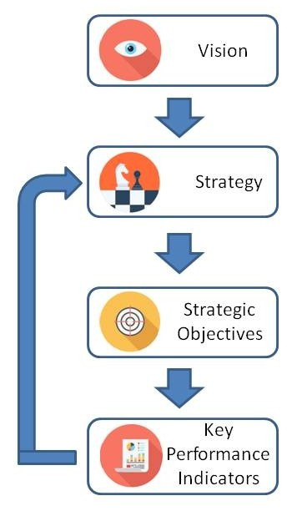
SOLUTION
Developed an automated complaint analysis system using AI
Uses OpenAI language models to understand complaint text
Maps each complaint to relevant KPIs (Key Performance Indicators)
Extracts structured insights such as reasons and issues
Outputs results in JSON/CSV format for further analysis

Slide 4
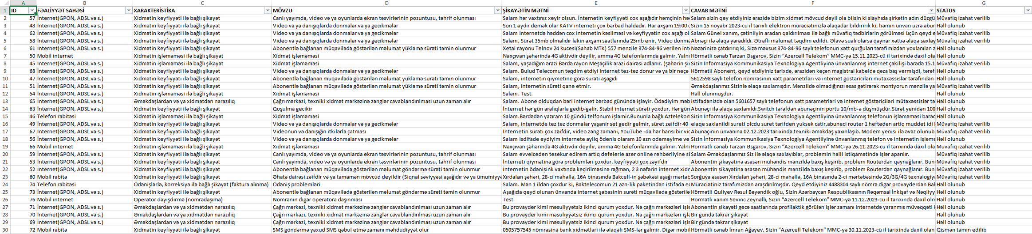
INPUT DATA
• Complaint dataset (Excel/CSV/ODS formats supported)
• Each complaint contains ID and textual description
• KPI table with KPI names and descriptions
• Optional telecom providers list
• System automatically detects required columns

Slide 5
System Architecture
1. Load input data using pandas
2. Normalize and preprocess complaint text
3. Build prompt including KPIs and complaints
4. Send request to OpenAI API
5. Parse JSON response from model
6. Save results incrementally and finally

Slide 6
Key Idea
• Transform unstructured complaint text into structured data
• Use LLM (Large Language Model) for semantic understanding
• Replace rule-based systems with flexible AI-based approach
• Enable automatic classification and explanation generation

Slide 7
How It Works
• Complaints are processed in batches (improves performance)
• Prompt includes complaint text, KPI list, and providers
• Model returns structured JSON response
• System extracts 'reason' for each complaint
• Results are validated and normalized

Slide 8
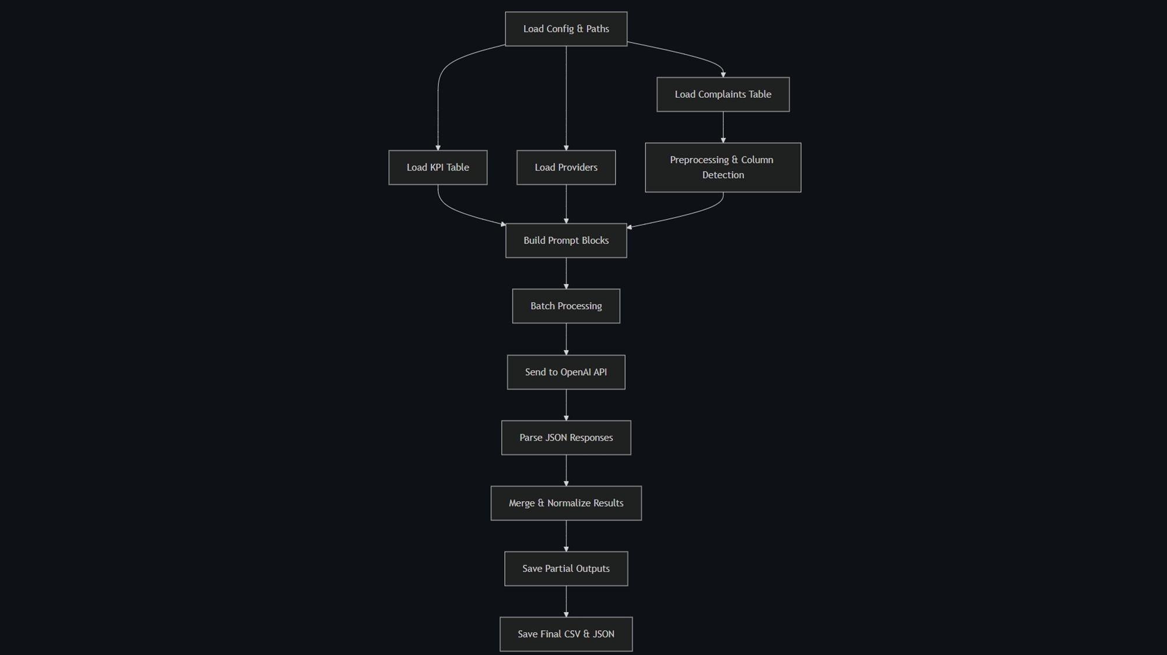

Slide 9
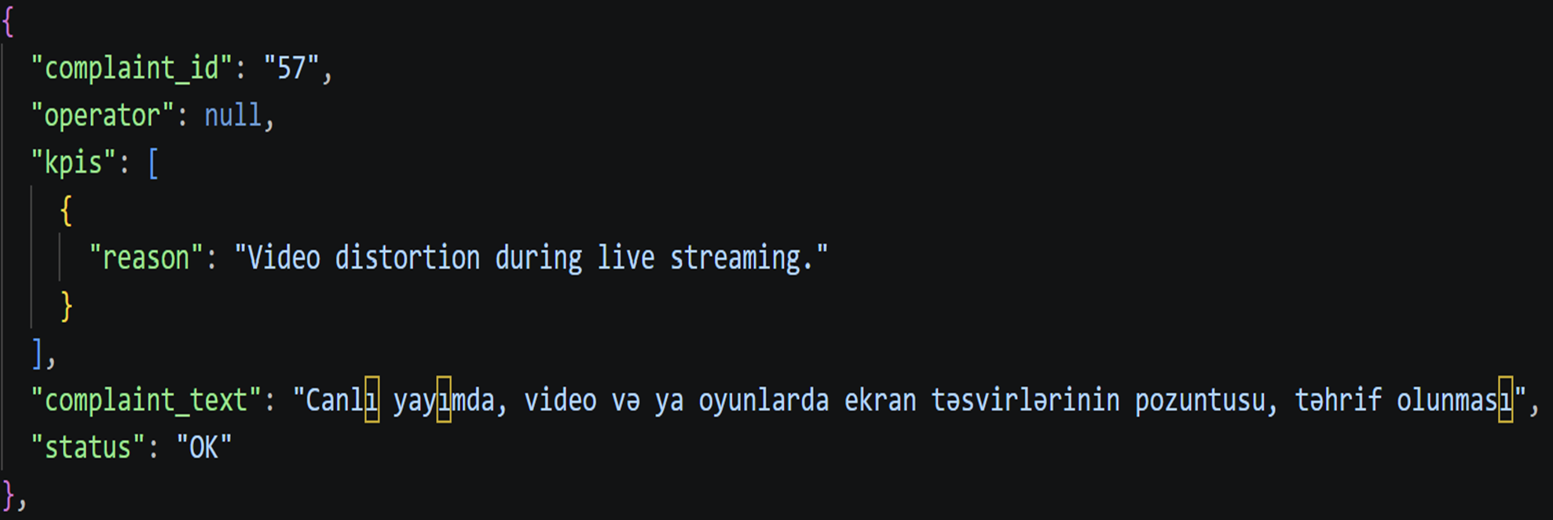
Example Output

Slide 10
Technologies Used
• Python (core programming language)
• Pandas (data processing and tables)
• OpenAI API (natural language processing)
• JSON / CSV (data storage formats)
• Multithreading (parallel batch processing)

Slide 11
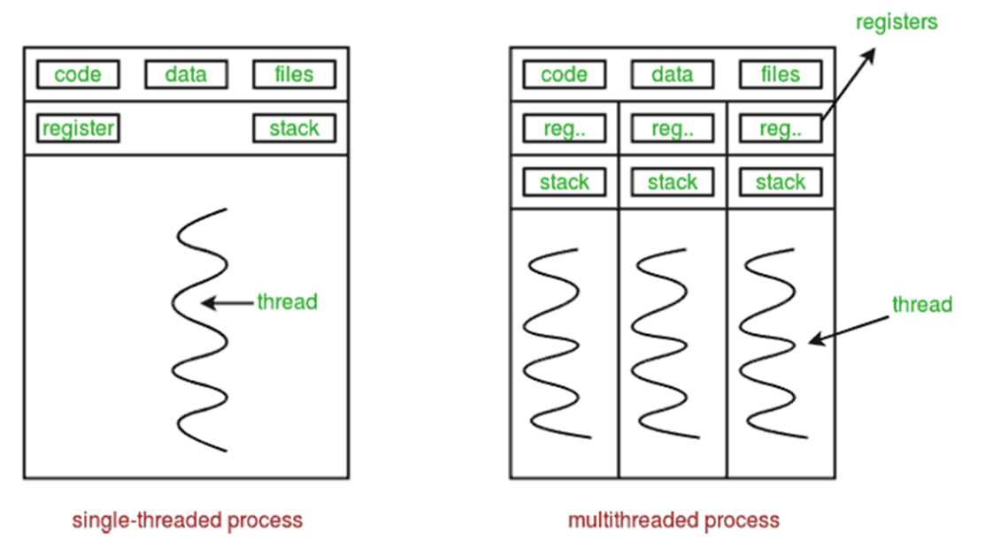

Slide 12
Features
• Automatic column detection (flexible input files)
• Batch processing for efficiency
• Parallel execution for faster processing
• Error handling for API failures
• Partial saving to prevent data loss

Slide 13
Challenges
• Supporting multiple file formats (CSV, XLSX, ODS)
• Ensuring correct JSON parsing from AI responses
• Handling API rate limits and errors
• Cleaning and normalizing messy real-world data
• Maintaining consistency in results

Slide 14
Conclusion
• Fully automated complaint analysis pipeline
• Converts text into structured insights
• Reduces manual work and increases efficiency
• Helps identify key telecom service issues
• Can be extended to real-world production systems

Slide 15
Thank you.

